Slide 1
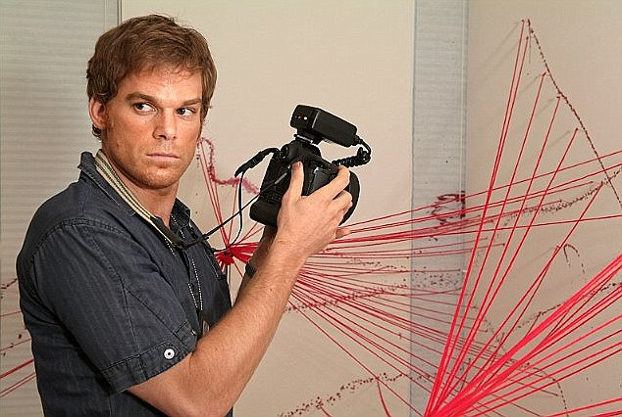
CRIMINALLY BAD Forensic SCIENCE
Eric Prebys
FRS-003-009

Slide 2
Comments
In this lecture, I’ll focus on criminal cases in the US
While bad science is used in civil cases and in defense, I consider this a bigger issue.
Other countries have both advantages and weaknesses compared to the US.
You could teach a full class in all the shady behavior that’s been used to put innocent people in jail and even to death.
I’m going to focus specifically on cases in which bad science has been used, and further restrict myself to bogus science that’s been widely accepted and used to put lots of innocent people in jail.
Even so, I’ll barely be able to scratch the surface.
There’s a LOT of detail on these slides
You’re not meant absorb it all today, but I’ve included links so you can study it later.

Slide 3
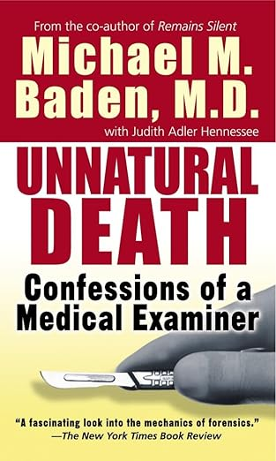
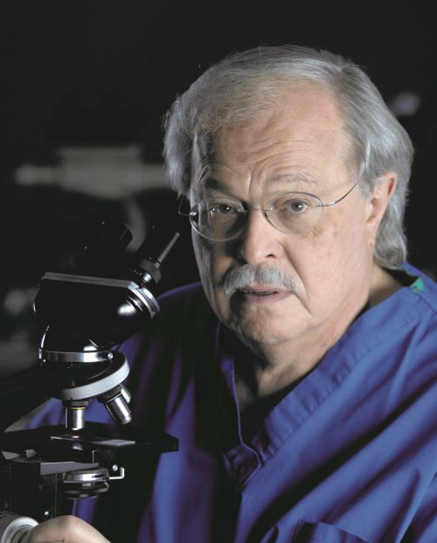
Michael Baden*
A number of years ago, I picked up this book -> at a yard sale.
It was stories about major cases, for which the author attributed confusion and misinformation to bad forensics, including
JFK Assassination
Klaus von Bulow
O.J. Simpson
A little googling told me he was perhaps the most famous forensic pathologist in the world, who had even had an HBO series for a while.
I invited him to give a colloquium at Fermilab and spent an entire, fascinating day with him.
He said something to the effect,
“There were things we thought were good science, like bite marks, that turned out to be total nonsense after DNA testing came out, and things we always knew were nonsense that prosecutors have used to put people in jail.”
He spends all his free time on The Innocence Project
More about that shortly.
*One of the most interesting people I’ve ever met.

Slide 4
What are the Stakes?
MANY people have been jailed, sometimes for many decades, who later turned out to be innocent.
Since 1973, almost 200 people have been freed from Death Row, about 29 through DNA evidence.
To date, no executed person has been officially exonerated, but there are several who were almost certainly innocent, based on
Later DNA analysis
Other flawed science used in the case
Witness recantation
Police and prosecutorial misconduct.

Slide 5
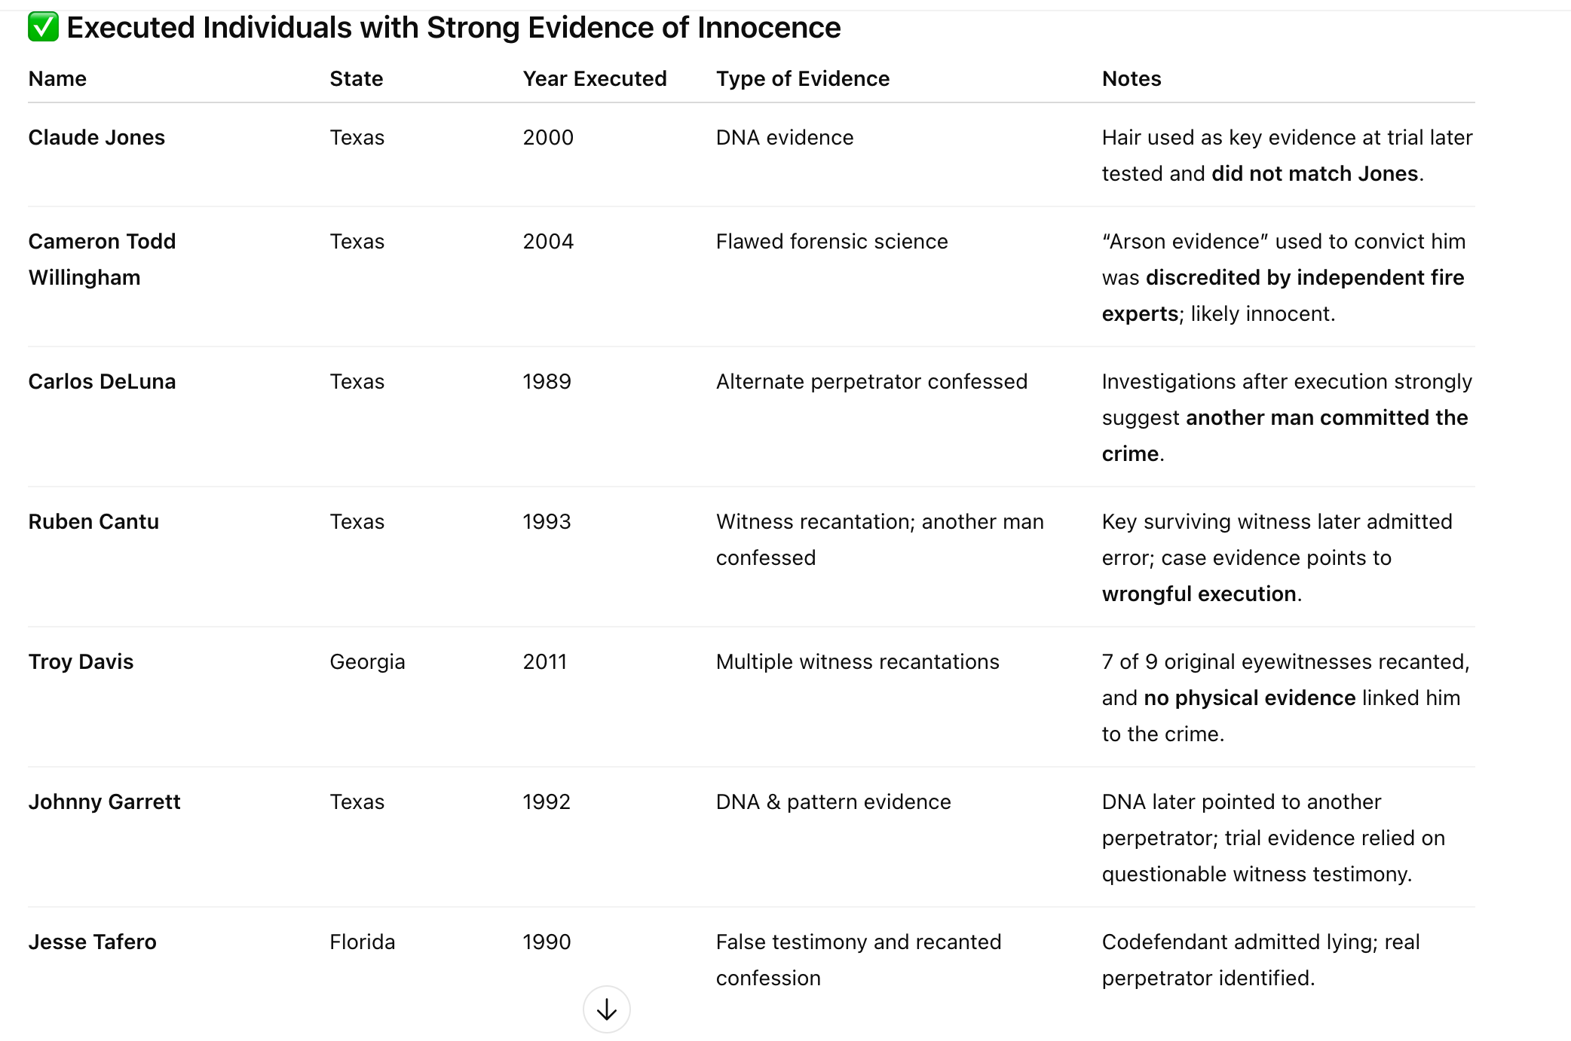
Executed People Who Were Probably Innocent
According to ChatGPT (sorry)

Slide 6
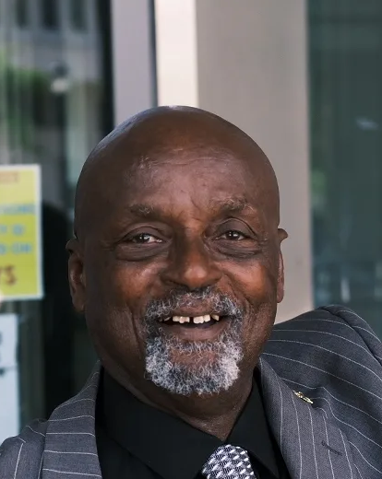
The Good Guys: The Innocence Project
I first heard about them from Michael Baden, who spends all his free time on their cause.
From their website:
“Founded in 1992 by visionary attorneys Peter Neufeld and Barry Scheck, the Innocence Project has been at the forefront of criminal justice reform, using DNA and other scientific advancements to prove wrongful conviction.”
Largely through their work, as of January 2022, 375 people incarcerated people were freed based on DNA evidence.
First DNA exoneration: 1989
Average number of years served: 14
Longest serving person freed: Leonard Mack, 49 years!
98% are male
69% were Black or Latino
69% involved eyewitness testimony
29% involved false confessions!

Slide 7
Science in the Courtroom
Science enters the courts in two ways
Forensics labs:
Government labs: Medical Examiner, Crime Scene Investigations, Centralized Crime Labs (e.g. at the FBI), etc.
Private labs: blood and DNA testing, etc.
Nominally impartial, but often lean toward being agents of the prosecution.
Expert witnesses:
People who testify on behalf of either the prosecution or the defense, based on their “expertise”.
Scientific or medical experts can be paid from $400-$1500/hour.
Not even the pretense of impartiality!
Each side hires the experts that support their version of the facts.
It goes without saying that if two “experts” in the same field disagree on facts, a court is NOT the best setting to determine who’s right.
Jurors can’t do their own investigations.
Will make their decisions based on who speaks better and maybe even who looks better in a suit.

Slide 8
Admission of Scientific Evidence*
“Frye”: Frye v. United States (1923):
Originally involved admission of lie detector (then based only on blood pressure).
Requires science to be “generally accepted” by the relevant community.
Key point: only allow “established” science in the courts.
Used by some states (e.g., New York, Illinois, Pennsylvania, Florida, California for certain cases)
Pros:
Simple and conservative.
Relies on scientific consensus.
Cons:
Can exclude new techniques that might have merit.
Interestingly, this standard has never been argued in the Supreme Court in over 100 years.
See, eg, Opening Arguments Podcast: “Polygraphs and the Limits of Scientific Evidence in Courts”

Slide 9
Admission of Scientific Evidence (cont’d)
”Daubert”: Daubert v. Merrell Dow Pharmaceuticals, Inc. (U.S. Supreme Court, 1993)
The case your read about in Voodoo Science
Five-point test:
Testability – Can the theory or technique be tested?
Peer review & publication – Has it been published or reviewed?
Error rate – Is there a known or potential error rate?
Standards and controls – Are there standards governing its operation?
General acceptance – Is it widely accepted in the relevant scientific community?
Key point: makes the judge the primary gatekeeper of scientific evidence.
Used in all Federal courts and all states that don’t use Frye
Pros:
More flexible; allows novel but scientifically sound evidence.
Encourages active judicial evaluation of science
Cons:
Puts more responsibility on judges, who may not have scientific expertise.
Can lead to inconsistent rulings.

Slide 10
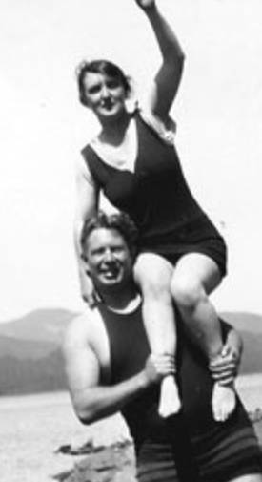

Speaking of Lie Detectors..
The first “lie detector” was developed by William and Elizabeth Marsden in the early 1920s.
It relied only on systolic blood pressure
The theory was that the stress of lying would increase a person’s blood pressure.
In the case Frye v. United States (1923), James Frye attempted to use the results device to appeal his murder conviction.
The appellate court ruled the evidence as inadmissible, because the science was not “generally accepted”
This became the “Frye Standard”, which we just discussed.
Fun fact: Elizabeth went on to create the Wonder Woman character, whose main tools were:
Bullet-deflecting bracelets
An invisible plane
The Lasso of Truth!

Slide 11
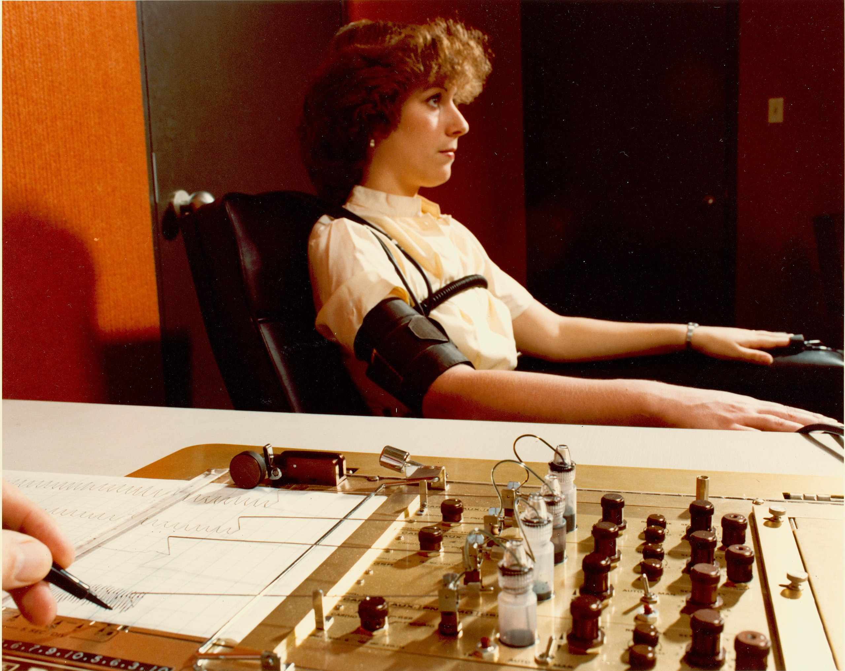
Polygraphs
Modern polygraphs use a number of biological metrics to measure stress, including
Blood pressure
Heart rate
Skin conductivity
Respiration
Polygraph results can be influenced by many things
The stress of the interview can yield false positives
“Pathological liars” can lie without stress.
There are also effective countermeasures
Numerous studies have put the accuracy somewhere between 80 and 90%
The fewer false positive you’re willing to live with, the more liars will pass
A lengthy NAS review concluded “polygraph tests can discriminate lying from truth telling at rates well above chance, though well below perfection”
Polygraphs are generally NOT admissible in court, unless both sides agree
SCOTUS case United States v. Scheffer (1998) determined they fail the Freye AND Daubert standards.
The ARE used during investigations, which can strongly bias investigators.
They are also used extensively during security and job interviews, in spite of their unreliability.

Slide 12
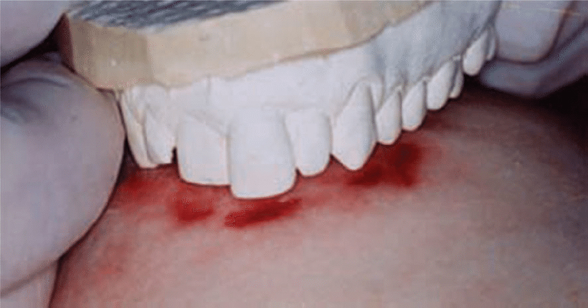
Bitemark Analysis*
The modern “science” of “forensic odontology” was born in 1970 at a forensics conference in Chicago.
The technique involves matching bite marks on a victim to a dental impression of the suspect.
The community of bitemark analysts grew, as did their own assessment of the technique’s accuracy.
Interestingly, because the technique was “generally accepted” within the “community” they had created, passed the generally more restrictive Frye test at the time.
It became a standard piece of evidence in criminal trials and was generally accepted as solid science.
However, there were concerns from the beginning:
Lack of an objective standard for matching. It came down to the judgment of the “expert”
The skin tends to deform when someone is bitten, meaning the pattern will generally not exactly match the teeth (again, judgment comes into play)
Once bitten, the area will frequently swell, again distorting the impression.
*check out “Bastards of Forensic Science” on the Behind the Bastards Podcast.

Slide 13
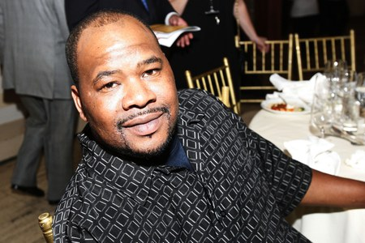
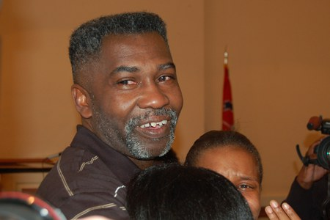
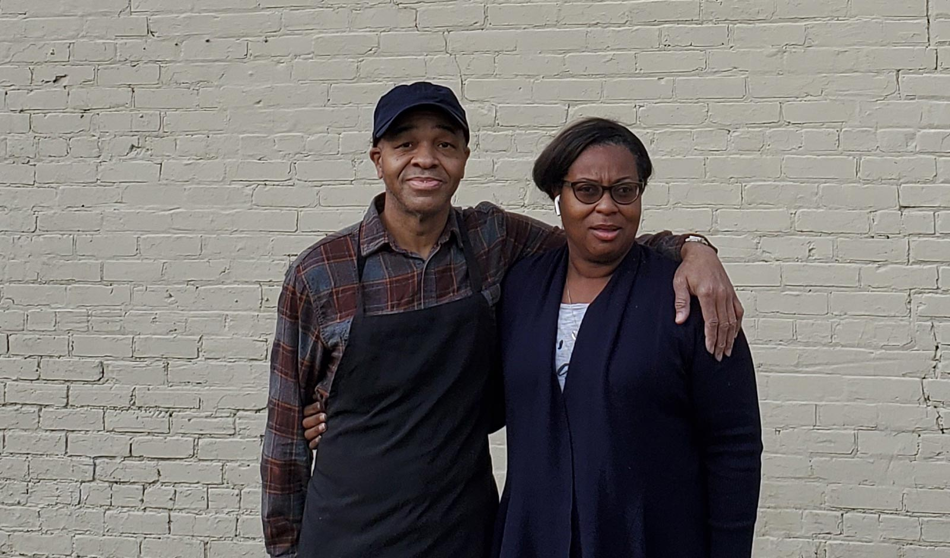
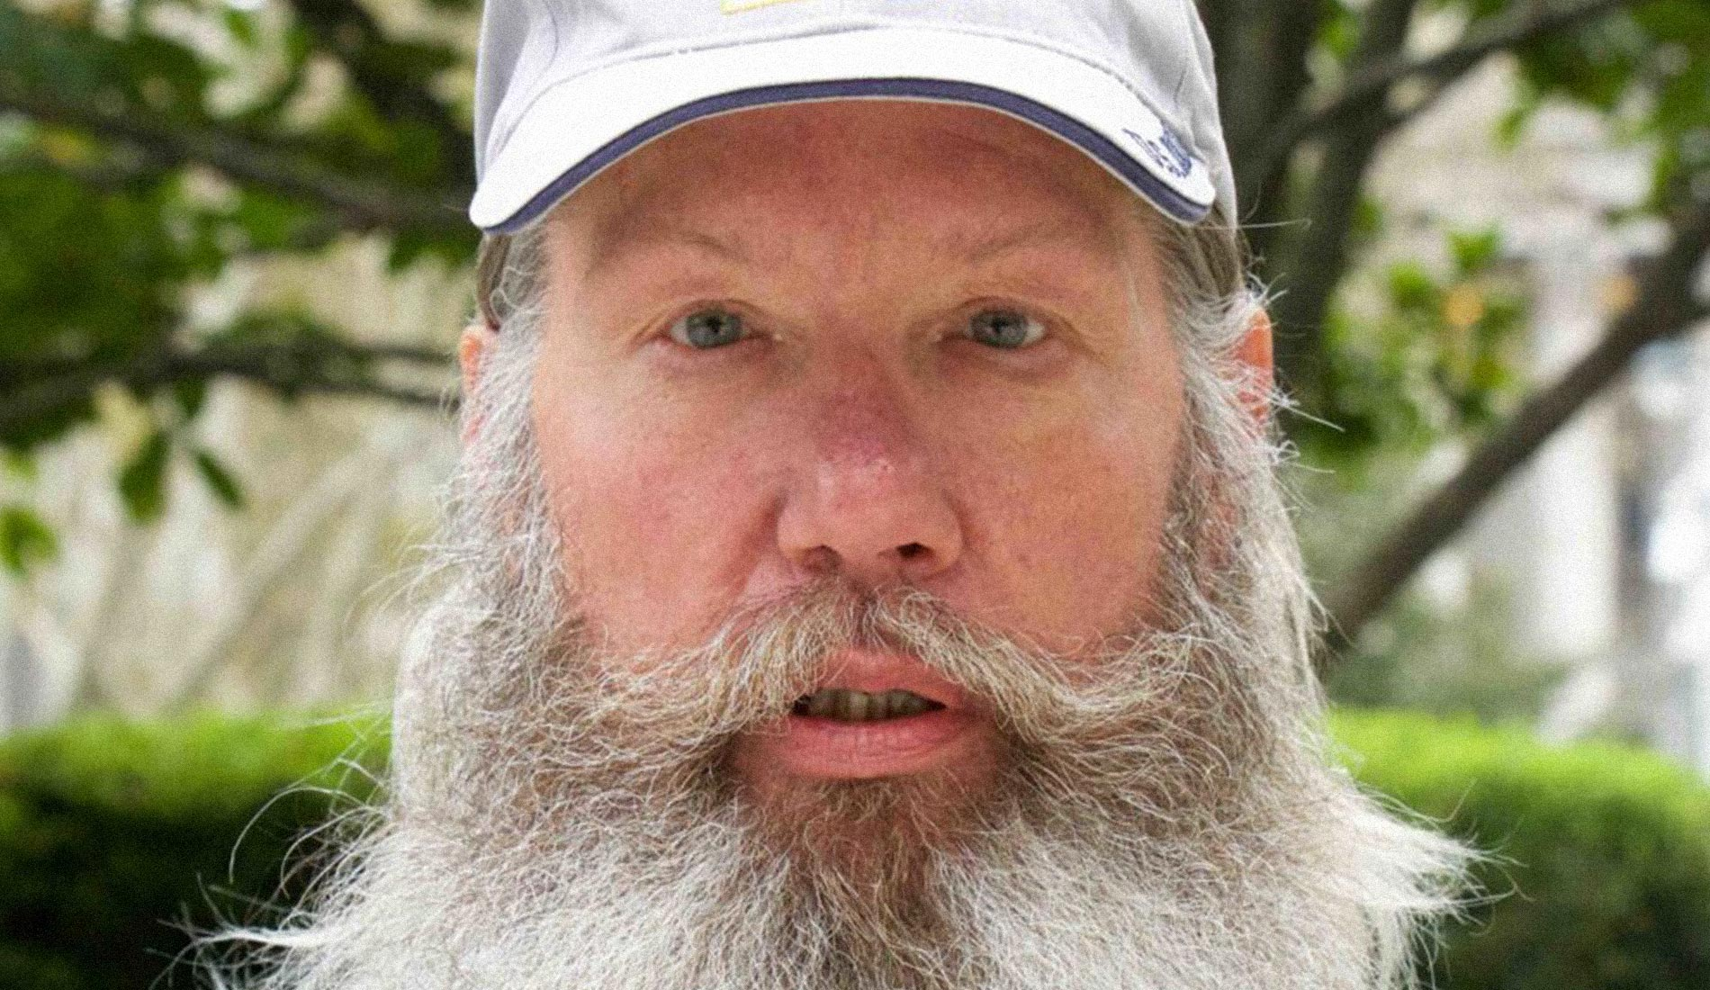
The Fall of Bitemark Analysis
Systematic studies of bitemark analysis on pigskin under “ideal laboratory conditions” have found false positive rates of 10-24% immediately after the bite was made and up to 90% 24h later [1]
Once DNA testing could be used to cross-check bitemarks, the technique was found to have a HUGE error rate.
To date, about 30 people who were convicted based on bitemark analysis have been freed, including:
Kennedy Brewer (1992) and Levon Brooks (1995):
Separately convicted of similar crimes: rape and murder of three-year-old girls
Convicted primarily on bitemark evidence
Brewer served 15 years on Death Row and Brooks served 16 years in prison when DNA proved that a different man had committed both crimes.
Eddie Lee Howard:
Convicted of the 1992 rape and murder of an elderly woman.
Again, convicted primarily on bitemark evidence.
Freed in 2021 after spending 26 years in prison, including Death Row
Keith Harward:
Convicted of the 1982 murder of a shipyard worker and the rape/murder of his wife.
TWO separate forensic odontologists matched his teeth to a bite mark.
Freed by DNA evidence after serving 33 years of a life sentence.
Needless to say, bitemark analysis is no longer considered reliable.

Slide 14
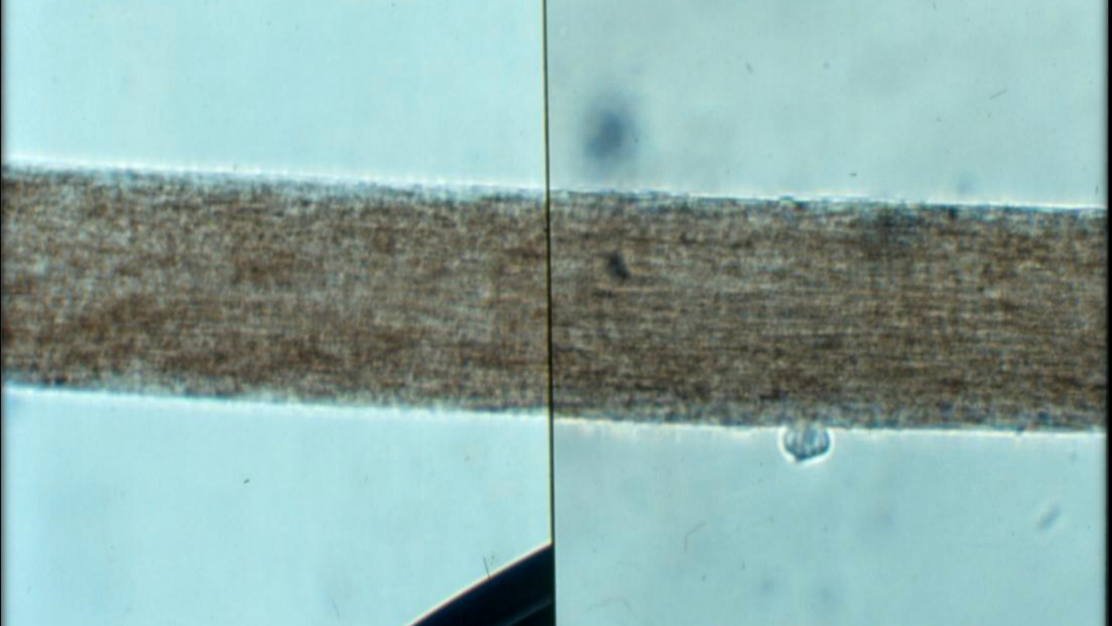
Microscopic Hair Analysis
The FBI has numerous labs used in the investigation of crime.
One of the most prestigious of these labs was the FBI’s Microscopic Hair Comparison Unit, considered the gold standard
This technique was used from the 1970s to the early 2000s, and it was the key – or even sole – piece of evidence in many cases.
As early as 1974, researchers within the FBI raised serious concerns about the reliability of this technique, but these reports were never made available to defendants!
Early DNA test could not be used on hair unless it contained a follicle, which most samples didn’t.
By the late 1990s, mitochondrial DNA testing (using the mitochondria instead of the full nucleus*) had developed to the point where it could be used to match hair samples and cross check the FBI lab.
The results proved the lab to be total voodoo science nonsense!
But it still took a while for the truth to get out.
*higher rate of false positives, but negatives are still absolute.

Slide 15
How Bad Was It? (VERY VERY bad!)
In April 2015, the FBI released an internal report that concluded.
This was the result of the inherent shortcomings of the technique, combined with sloppy and overconfident investigators.
At the time of this report, they had reviewed 500 out of about 3000 cases, and identified 296 in which hair analysis had resulted in a conviction. Of these
They concluded that erroneous statements had been made in 257 (96%) of the cases!
Of the 35 people who were given the death penalty, erroneous statements had been made in 33 (94%)!
Nine of these people had already been executed and five others had died on Death Row at the time of the report.
A few of the more notable mistakes…
*remember what I said about eyewitnesses and different races.

Slide 16
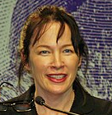
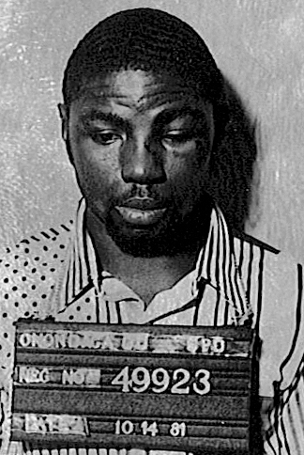
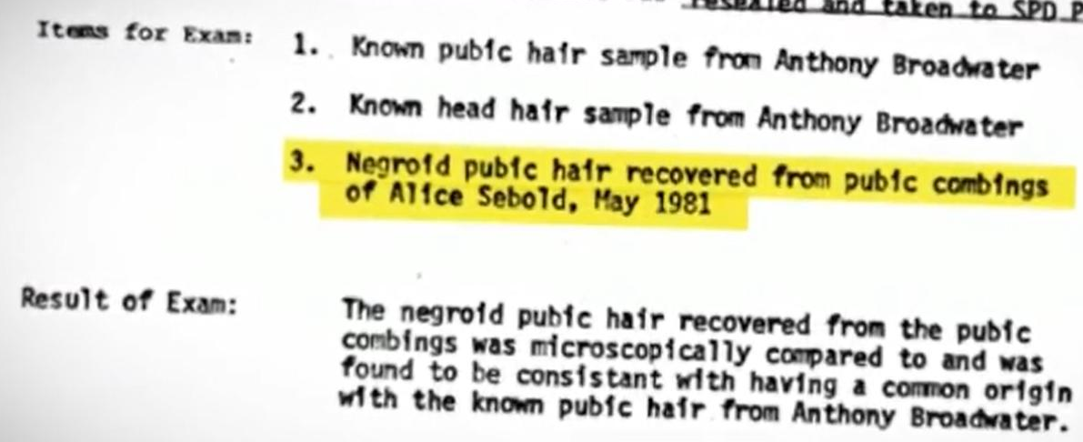
Example: Anthony Broadwater
In 1982, Alice Sebold was raped while attending University of Syracuse.
She would go on to write ”Lucky” about the experience.
Also wrote “The Lovely Bones”, which became a movie.
The police were initially unable to locate a suspect
Five months later, they arrested Anthony Broadwater for the crime, base on the fact he said, “Haven’t I seen you somewhere before?” when seeing Sebold.
Broadwater was convicted based on two pieces of “evidence”
Sebold, who had identified a different Black man in Lineup, later identified Broadwater in court.
The FBI lab found a “negroid pubic hair, consistent with having a common origin” as Broadwater’s.
He spent 16 years in prison, and then had to register as a sex offender.
Timothy Mucciante, working on a film adaptation of Lucky, noted discrepancies in Sebold’s story.
He hired an investigator to look into the case, and in 2021, Broadwater was finally exonerated.

Slide 17
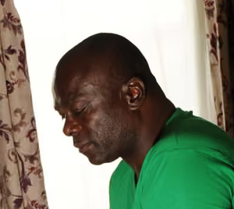
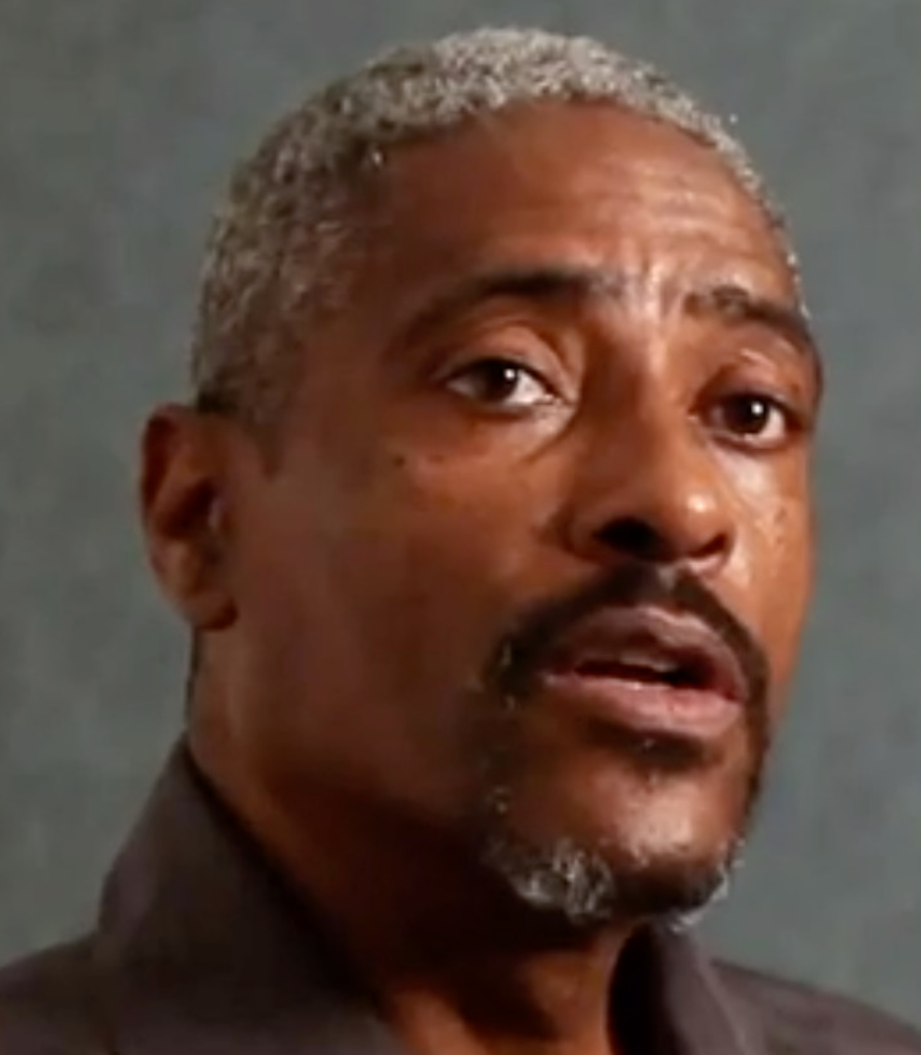
Other Cases
Kirk L. Odom
Odom was convicted of rape in 1982, based on questionable eyewitness testimony (she had only seen him in dim light) and a “negroid hair” sample, for which the FBI greatly overstated the probability of a match.
He spent the next 22 years in prison and the next 9 as a registered sex offender.
In 2012, he was finally exonerated when DNA tests on the hair sample and semen samples proved it could not have been him.
Santae Tribble
In 1978, 17-year-old Tribble was convicted of murder based only on nine hairs found in one of the stocking mask the killer had worn.
In spite of the fact he had multiple alibi witnesses putting him in another city, the fact that the FBI agent testified that there was only a “1 in 10 million chance” that the hair was a mismatch carried the day.
He spent the next 23 years in prison.
In 2012, DNA evidence completely exonerated him, and they proved the FBI could not even reliably distinguish human hair from animal hair.

Slide 18
FBI Hair Lab: Epilogue
These are only a few of the most egregious cases.
Only 500 of 3000 cases had been examined at the time of the FBI report.
I can’t find any updated numbers on the remaining cases, but in 2017 Jeff Sessions terminated the “Forensic Science Commission”, which had been investigating this and other questionable forensics.
If you simply scale up the numbers, you get ~1500 bad convictions and ~200 bad Death Row sentences.
In the end, the biggest problem was that again and again, agents dramatically overstated the reliability of the matches, even according the the FBI’s internal assessments at the time.
This put many innocent people in jail, and probably to death.
To my knowledge, no one has ever been punished in any way for this.

Slide 19
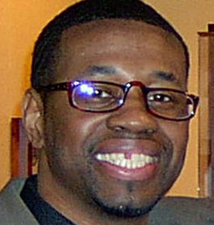
But Fingerprints are Good, Right?
Actually, the jury is still out (pun intended)
They’re acknowledged to be pretty reliable IF you have complete fingerprints, but in many cases there are only partials, which is when experts disagree.
A 2009 report by the American Academy of Sciences shed doubt on the accuracy of fingerprints
Lack of quantitative standards.
Disagreement of experts
Inconsistency of accuracy in tests
Official claim is 0.1% false positives, but other studies show 10% or more.
Example:
Stephan Cowans was convicted of the 1997 murder of a police officer.
He was convicted based on eyewitness testimony and a single latent thumb print at the scene.
Freed in 2004 by DNA evidence after serving 6 years in prison.

Slide 20
Ignoring Science: Eyewitnesses and Human Memory
MANY prosecutions rely primarily on eyewitness testimony.
The problem is that eyewitness testimony has been shown to be extremely unreliable.
Eyewitness testimony has been involved in 70% of established wrongful convictions.
Effectively useless when identifying a person of a different race!
Human memory is very unreliable in general, and there are many ways to instill false memories
Suggestion
Coercive interview tactics
Hypnosis, which is still admissible in court in many parts of the US, despite its demonstrated unreliability.

Slide 21
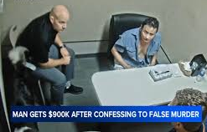
Coercive Interrogation
Police interrogators are very good at getting people to confess to things, whether or not they’re guilty.
29% of exonerated convictions involved false confessions!
Not that long ago, this involved actual beatings, but now that interviews are videoed, the are more “subtle”. Example:
In 2018, Tom Perez called the police in Fontana, CA to report his father missing.
The police became suspicious, and began a 17-hour interrogation of Perez.
They presented him with fabricated evidence and threatened to kill his dog.
Perez finally confessed to murdering his father – who showed up in perfect health a short time later!
Even after realizing the father was alive, they continued to interrogate Perez.
They killed his dog anyway.
Perez was recently awarded a $900,000 settlement over the trauma.
Now let’s imagine what happens when children are involved…

Slide 22
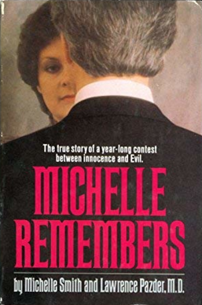
“Repressed Memories” and the Satanic Panic
In 1980, Canadian psychiatrist Lawrence and his patient (and eventual wife*) Michelle Smith wrote “Michelle Remembers”, which claimed that under hypnosis, she recovered repressed memories of Satanic Ritual Abuse.
This book became wildly popular and helped kick off the “Satanic Panic”
Allegations of backwards messages on rock albums
Satanists behind every doorway
LOTs of similar stories (see the clip I sent you. Oprah was a big cheerleader for this.)
Attempts to investigate the story turned up lots of problems
For example, he claimed Anton Levay and the Church of Satan were involved, but that was formed years after the alleged events.
The book is now generally accepted to be a complete fabrication.
Nevertheless, the damage was done. Therapists all over the country began to interview children and – through extremely leading questions sometimes hypnosis – came up with lots of “repressed” stories of Satanic rituals.
*no red flags there!

Slide 23
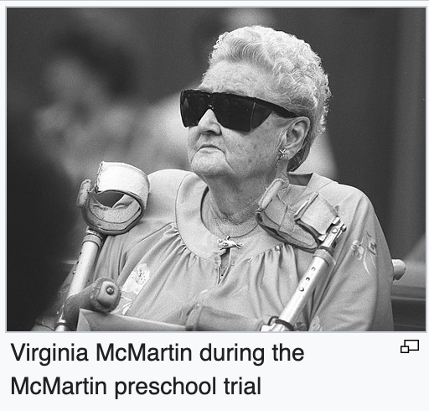
McMartin preschool trial
In 1983, Judy Johnson accused her ex-husband and Ray Buckley, one of the teachers at the McMartin preschool of sexually abusing her son.
Other students at the school were interviewed about the school.
While hypnosis wasn’t used, the investigators were clearly inspired by Michelle Remembers and asked highly leading questions.
They began to tell stories of – you guessed it – Satanic ritual abuse by many on the school staff
They also told stories of witches flying, traveling in a hot air balloon, and being taken into hidden tunnels under the school (which did not exist)
One student identified a picture of Chuck Norris as one of the attackers!
In spite of the craziness of the stories, the parents came to believe them and media coverage accepted the story uncritically.
The resulting trial lasted 7 years and cost $15M – the longest and most expensive trials in US history at the time.
In the end, all were acquitted, but Ray Buckley had spent five years in jail at that point and the school had spent all of their money on defense.
While acknowledged to be nonsense now, the acquittal was widely seen at the time as a miscarriage of justice.
Opray Winfrey even had a special show where the parents expressed their outrage.

Slide 24
Other Example Cases
Wee Care Nursery
23-year old Kelly Michaels was accused of using a rectal thermometer on a student, which she denied.
After interviewing other students, she was accused of performing daily Satanic rituals without the knowledge of the other staff.
She was convicted of 115 of sexual abuse and sentenced to 47 years in prison.
Ironically, she was acquitted of ever using a rectal thermometer!
She we released after 5 years when a lawyer came out of retirement to argue her case pro bono.
Oak Hill satanic ritual abuse trial
In the summer of 1991, the therapist of a three-year-old child being treated for behavioural problems alleged that school owners Fran and Dan Keller had sexually abused the child.
Under questioning, other children told stories of ritual sexual abuse, animal sacrifice, and plane trips to Mexico!
At trial, the first child testified that no abuse had taken place, but that she had been coached to say it had!
Nevertheless, they were were sentenced to 48 years each.
They were released in 2013, after serving 22 years.
In 2017, there were fully acquitted and awarded $3.4M for spending a third of their lives in jail.

Slide 25
Satanic Panic Summary
There were over a dozen high profile cases of Satanic Ritual Abuse, based on “recovered memory” testimony of children.
Many people spent years in jail.
All were eventually released and exonerated.
ALL the cases were acknowledged to be profoundly flawed.
There were over 12,000 accusations of Satanic Ritual Abuse in the 1980s and early 1990s!
While an extremely small number of those turned out to involve genuine, not a single accusation of ritual abuse has stood the test of time.
Everything old is new again:
Highly organized Satanic Ritual Abuse is central to the QAnon narrative
In 2016, he Pizzagate accusations led Edgar Maddison Welch to shoot up Comet Ping Pong Pizza, in Washington DC, looking for a basement that didn’t exist.
Lawmakers in Utah recently introduced a bill outlawing “Ritualistic Child Sexual Abuse”
In spite of the fact that child sexual abuse is already illegal (duh!)
It’s championed by Kimberli Raya Koen, who claims to have “recovered memories” of elaborate Satanic Ritual Abuse as a child.
Highly coercive interview techniques and even hypnosis are still used in court, in spite of the evidence that memories can be easily manipulated.

Slide 26
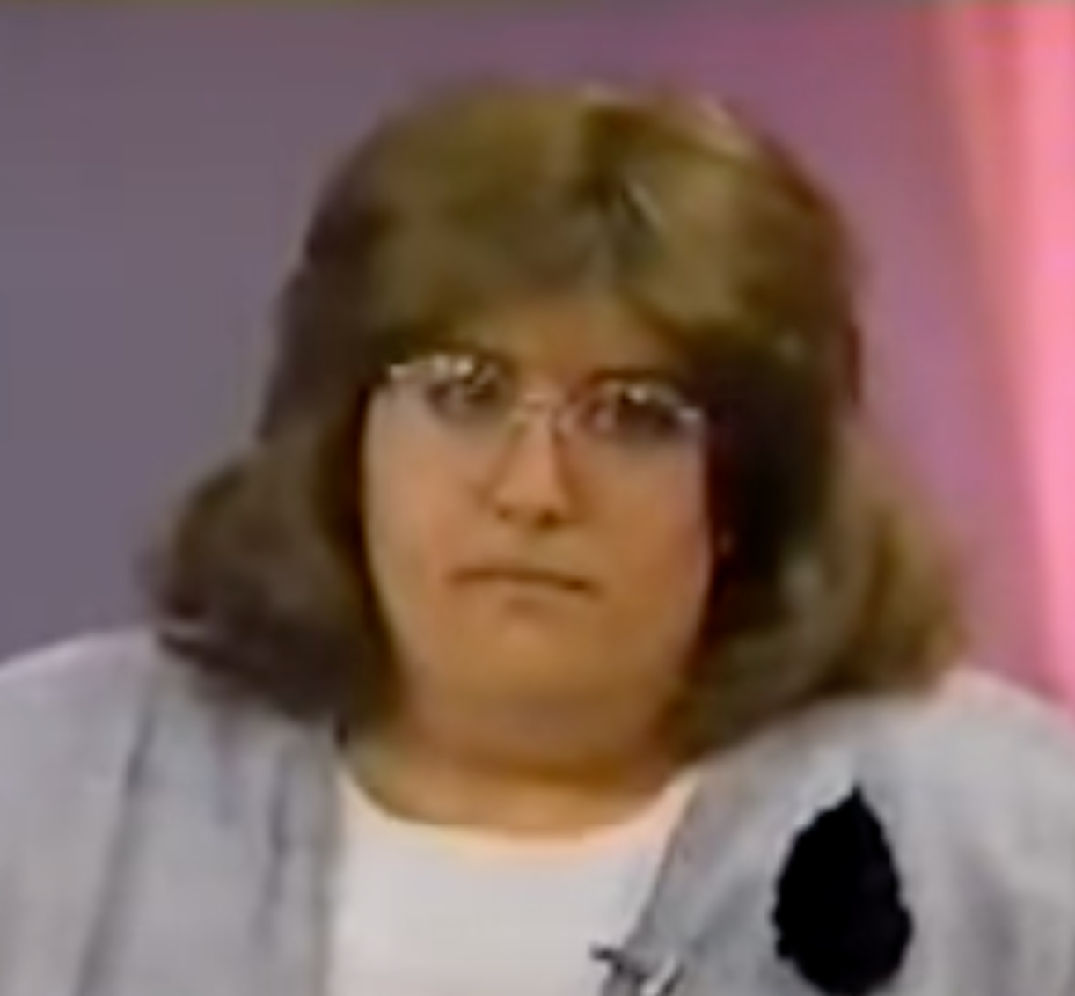
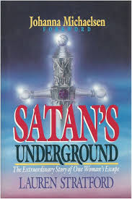
Comments about the Video Clip
This was an interview with ”Lauren Stratford”, who had just written the book Satan’s Underground, about her “recovered memories” of Satanic Ritual Abuse.
Michelle Smith is also on the stage
A short time later, an investigation by the Christian Magazine Conerstone concluded
Her real name is Laurel Rose Willson
ALL of the stories about her childhood were fabricated, including the basic facts about her home and family.
She had a long history of mental illness and making false accusations.
A decade later, she changed her name again to Laura Grabowski and claimed to be a Holocaust survivor who had been tortured by Josef Mengele.
Her book is still for sale at Amazon
It gets mostly 5-star reviews.

Slide 27
Parting Comments
I left out a LOT. See, eg
Blood spatter analysis
Arson Analysis
If you’re ever on a jury, take any expert testimony with a grain of salt.
If two experts disagree on the same topic, take the explanation that exonerates the accused. If two experts disagree on the same topic, take the explanation that exonerates the accused.
Be very skeptical of eyewitness testimony, particularly involving a different race.
I’ve talked about things that all used to be considered good science, so be suspicious of anything new!
Always remember, the standard is “beyond a reasonable doubt”. “Probably guilty” is still innocent in court.

